Slide 1
Online Courses
Class Name: PF1123
Group Name: Group_01
Member: Quan Van Vi
Ha Quang Anh

Slide 2
Objectives
Instructor:
Course Creation
Engagement
Monitoring and Assessment
Income Generation
Student:
Enhance Knowledge
Develop Skills
Customize Learning
Certification

Slide 3
Introduction to Project
The Online Course Platform provides an efficient and user-friendly management and learning system for instructors and students. Key features include course management, enrollment, search, and progress tracking, optimizing the user experience

Slide 4
Customer Requirements
User (Student, Instructor) login
Show courses
View course details
Register the course and payment
Learning and learning progress
Course evaluation
Account management
Course management

Slide 5
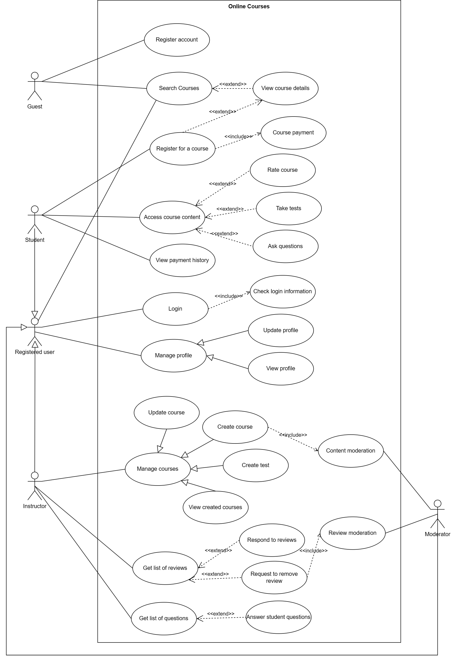
Use Case

Slide 6
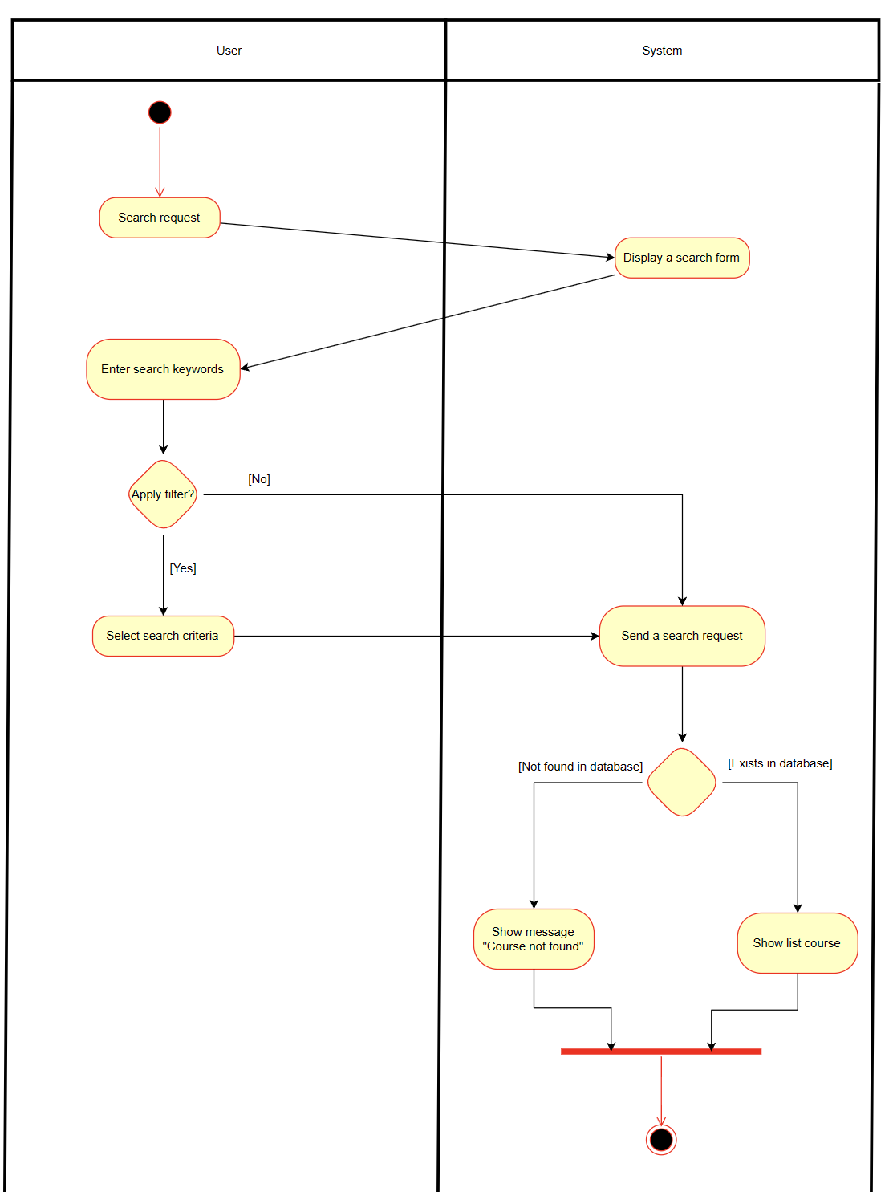
Activity Diagram
Search course:

Slide 7
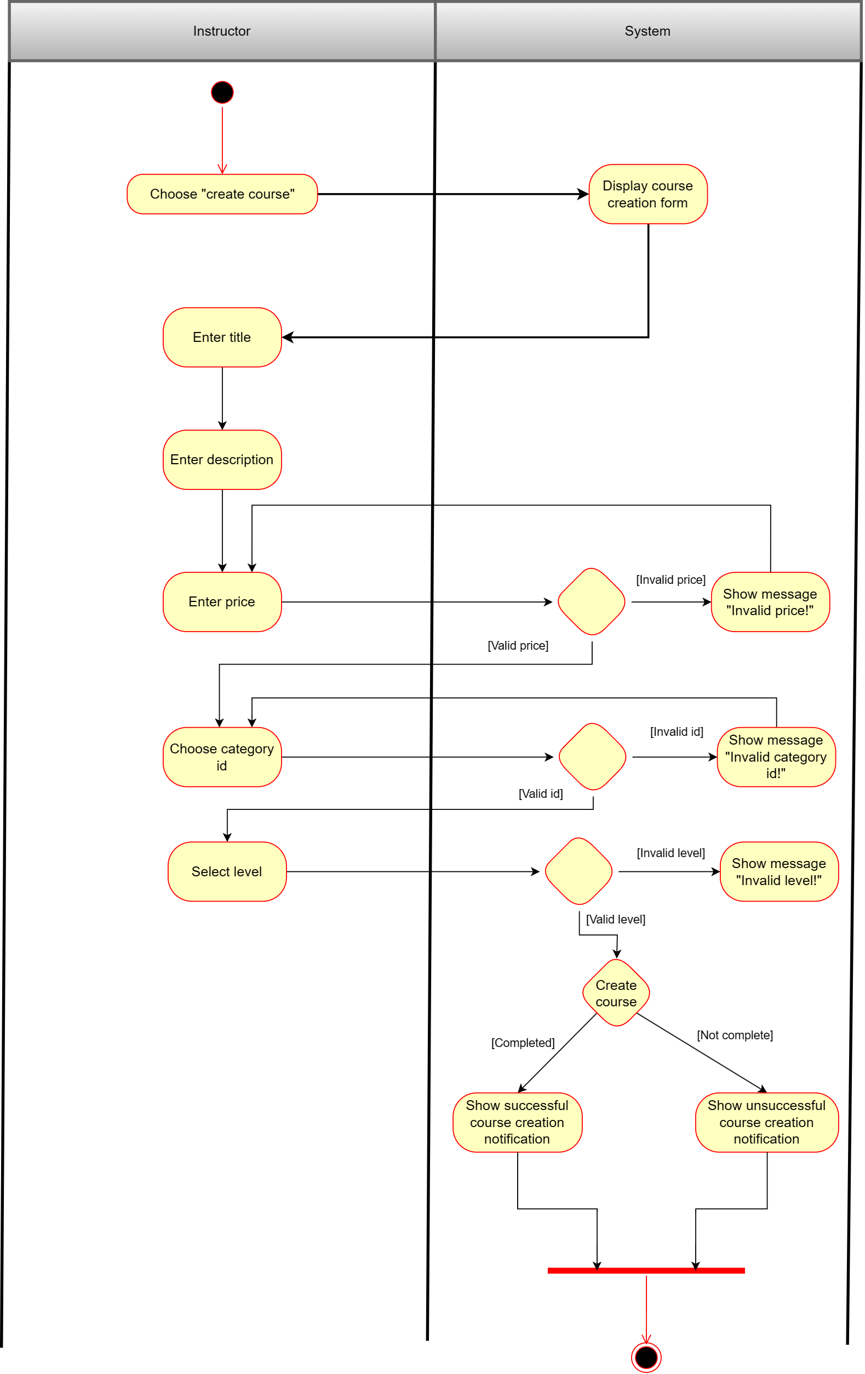
Activity Diagram
Create course:

Slide 8
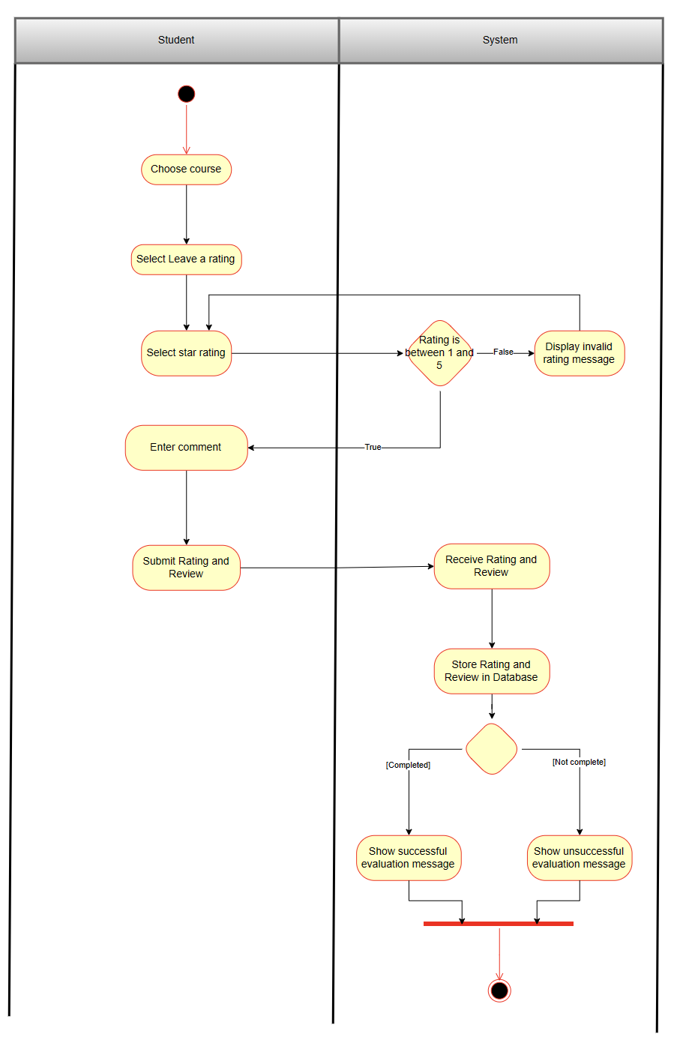
Activity Diagram
Evaluate a course:

Slide 9
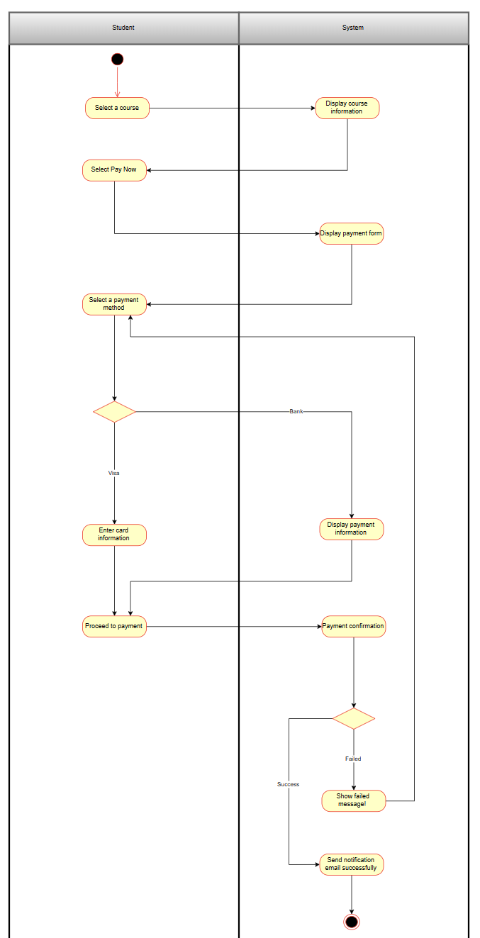
Activity Diagram
Payment:

Slide 10
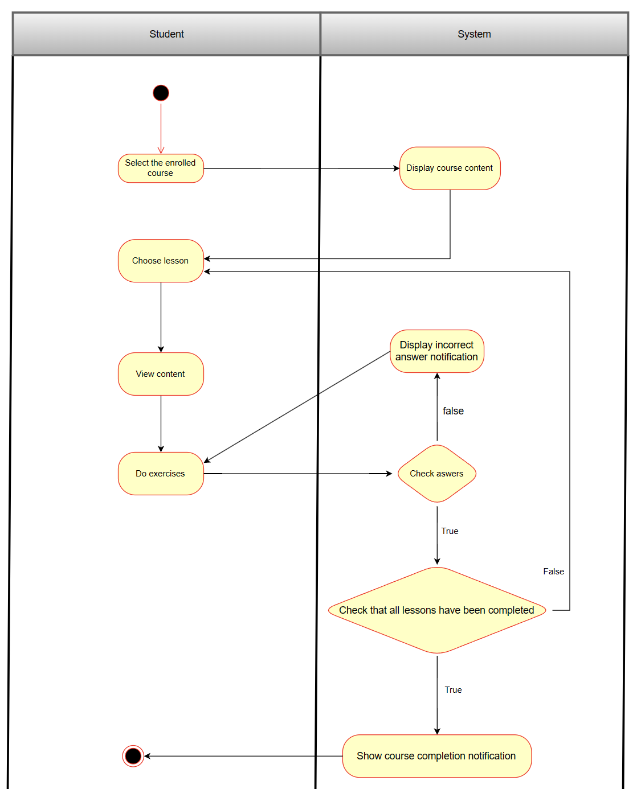
Activity Diagram
Learning:

Slide 11


UI Design
Login:
Register:

Slide 12

UI Design
- Home page:

Slide 13

UI Design
- Instructor Menu:

Slide 14
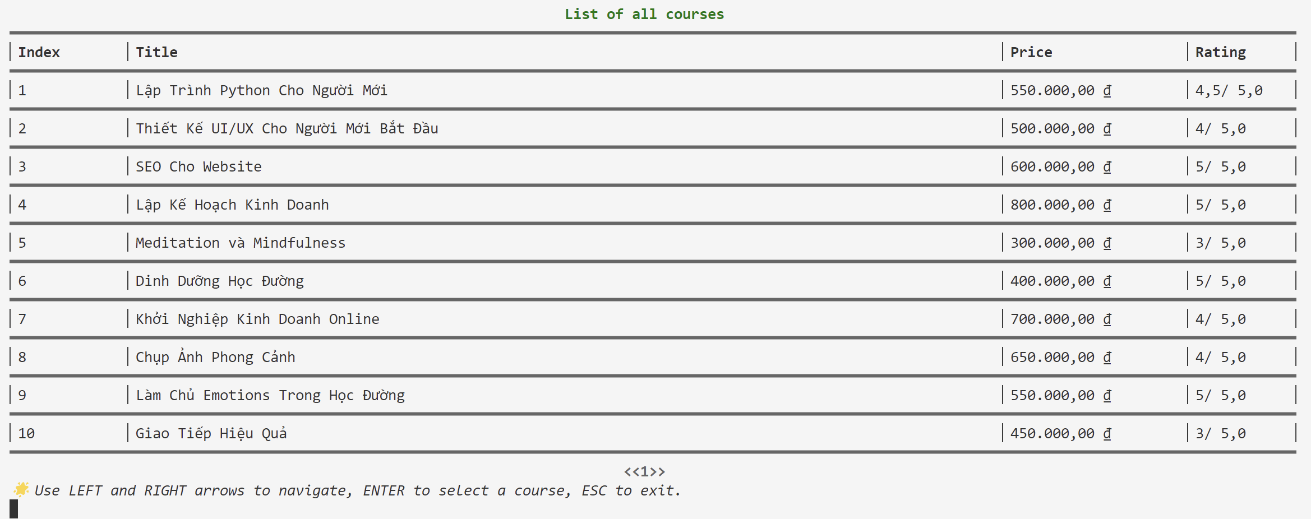
UI Design
- List of courses:

Slide 15

UI Design
- Learn:

Slide 16
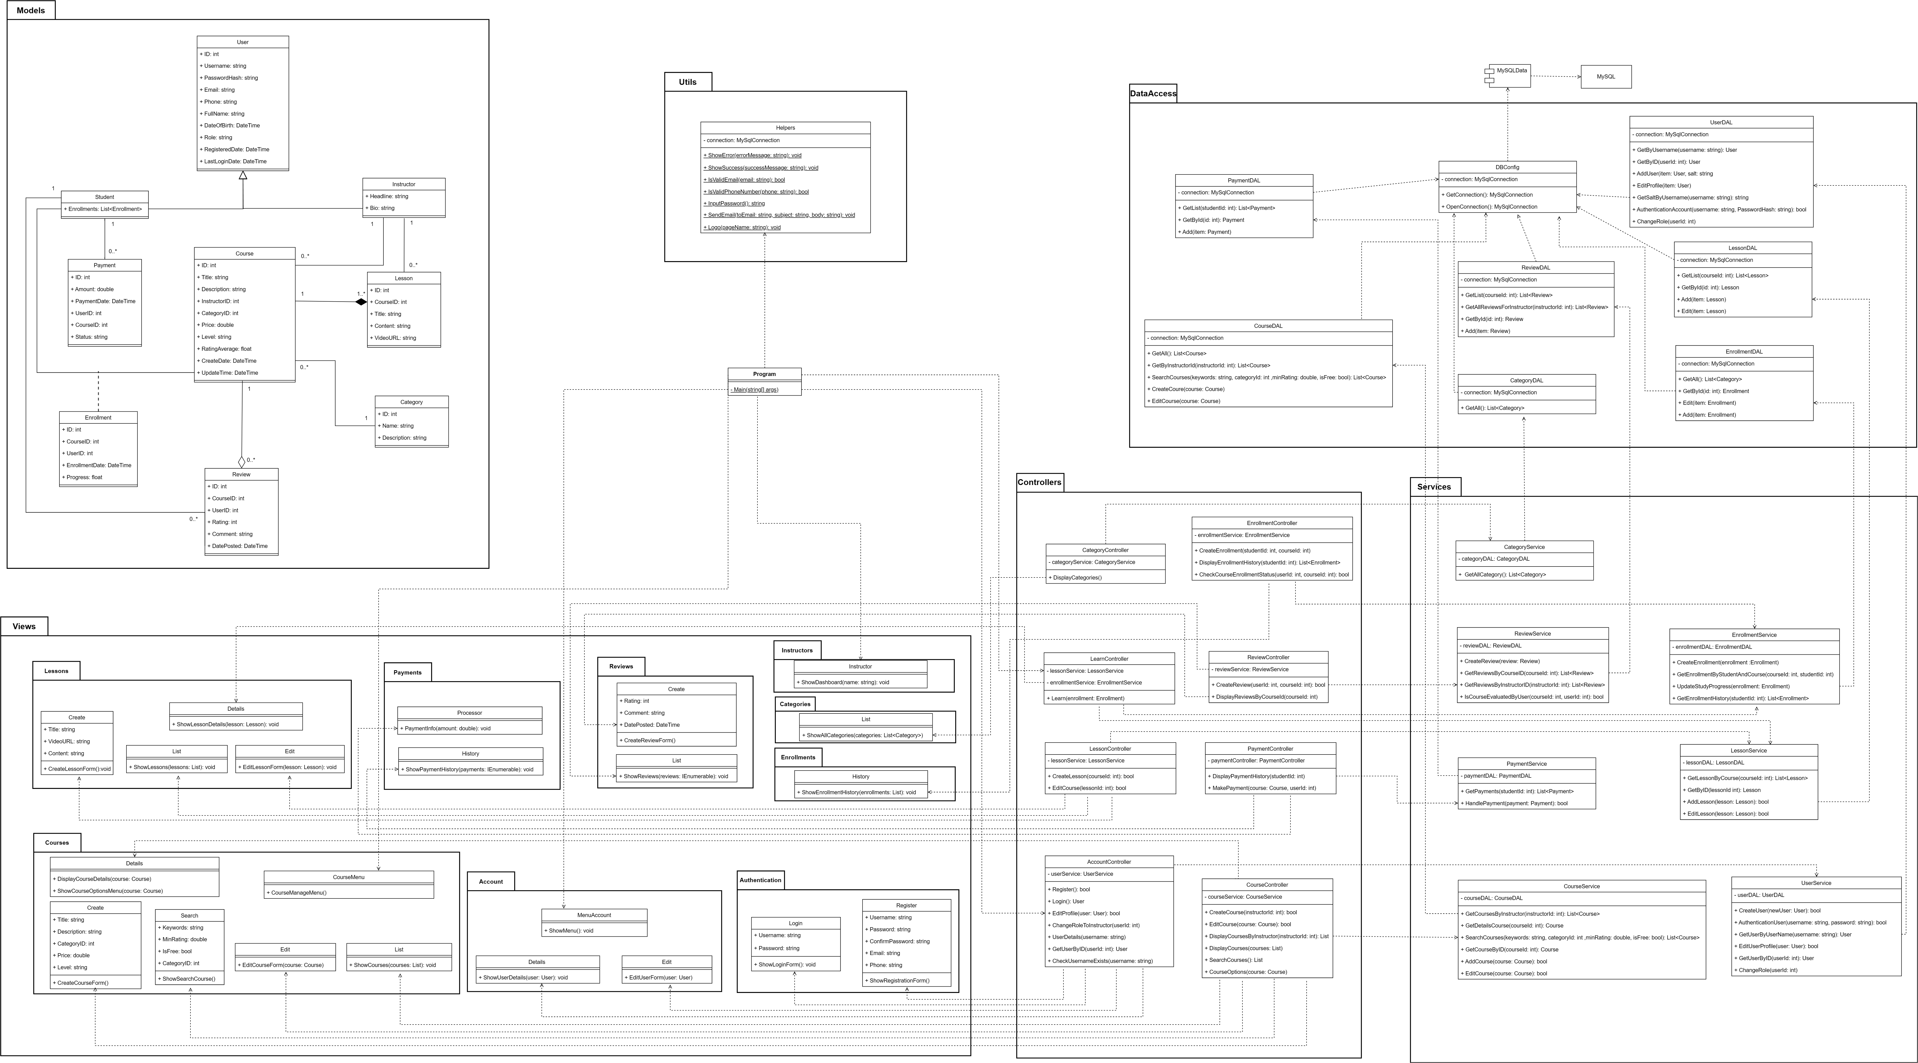
Class Diagram

Slide 17
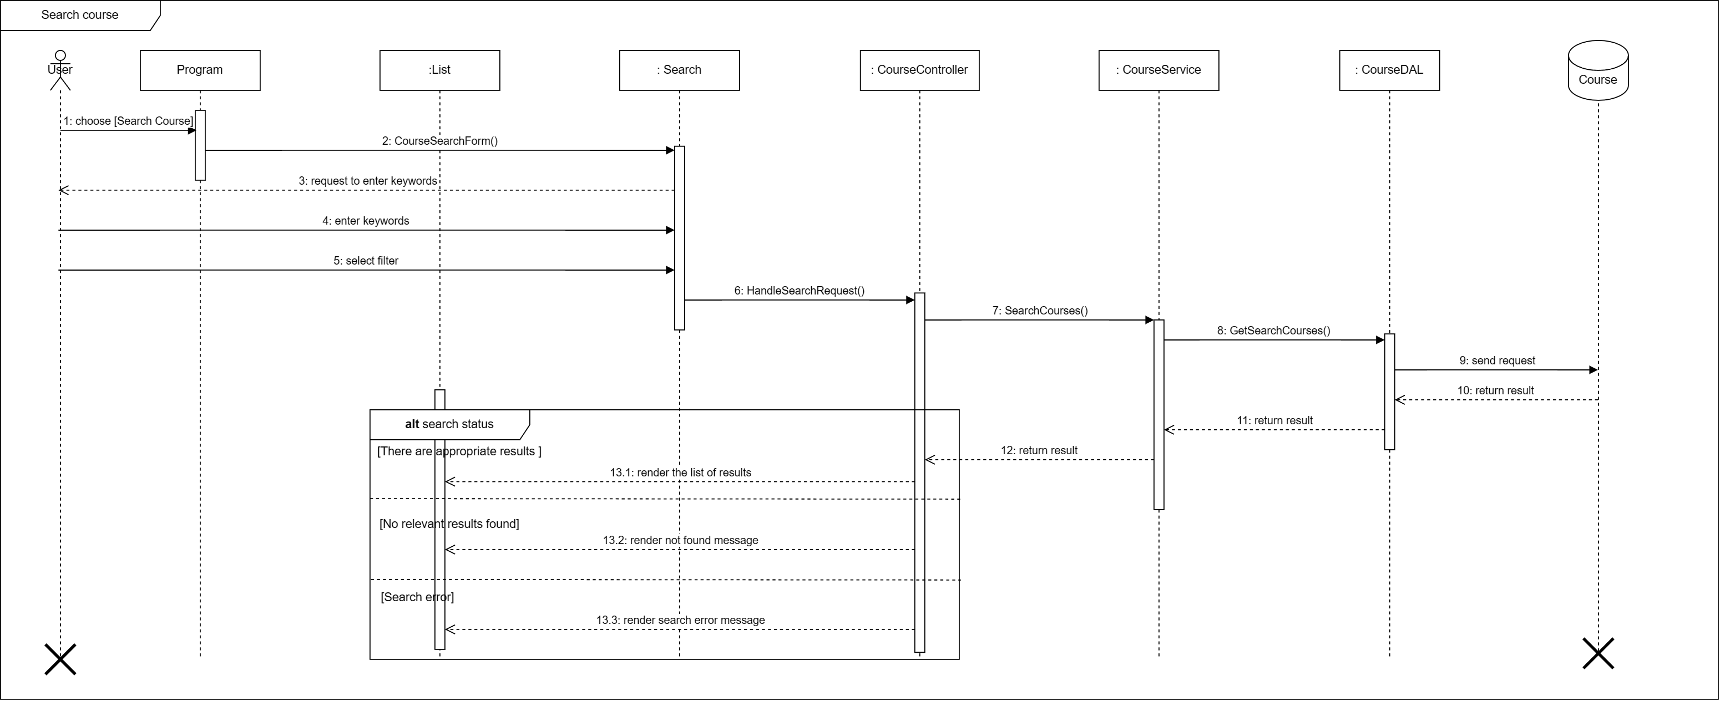
Sequence Diagram

Slide 18
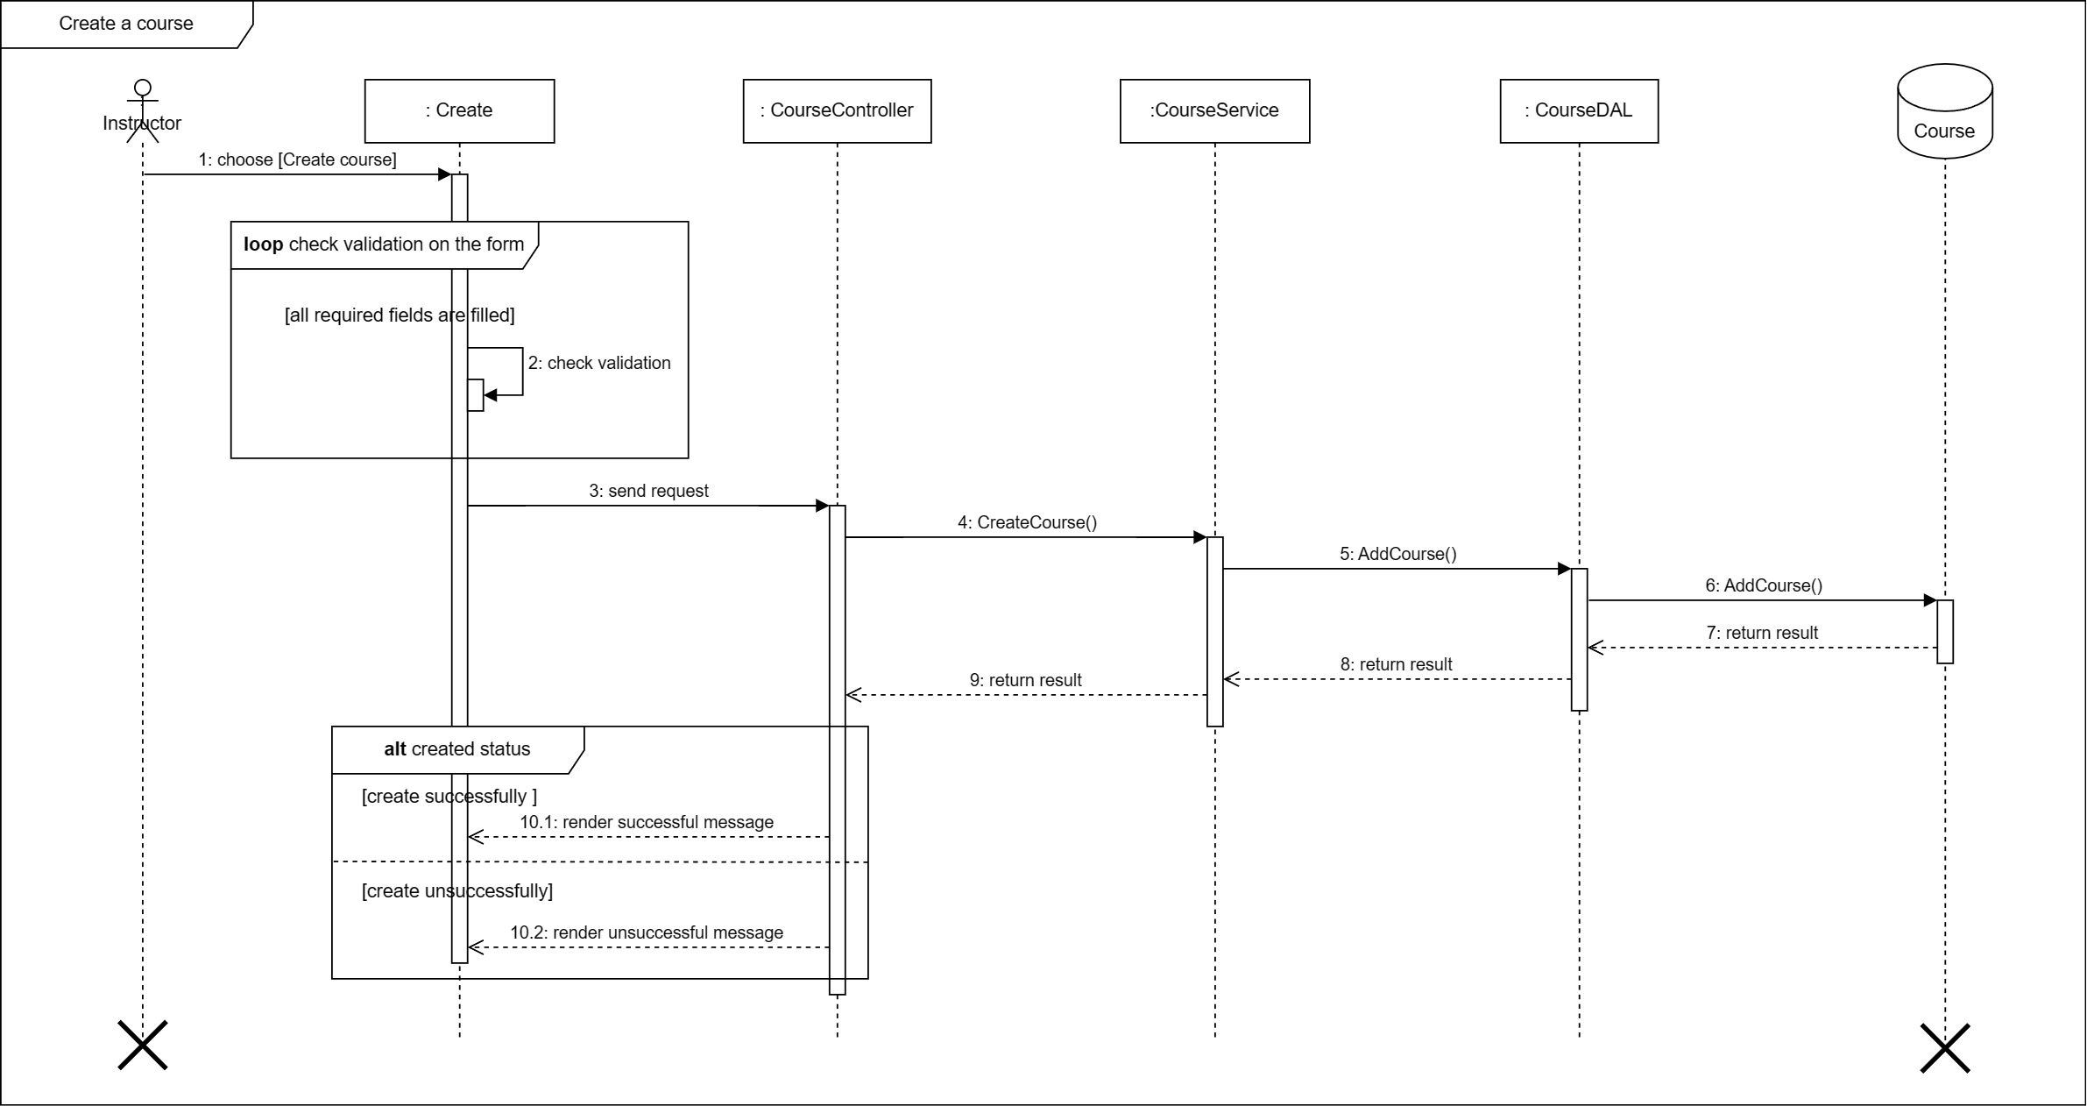
Sequence Diagram

Slide 19
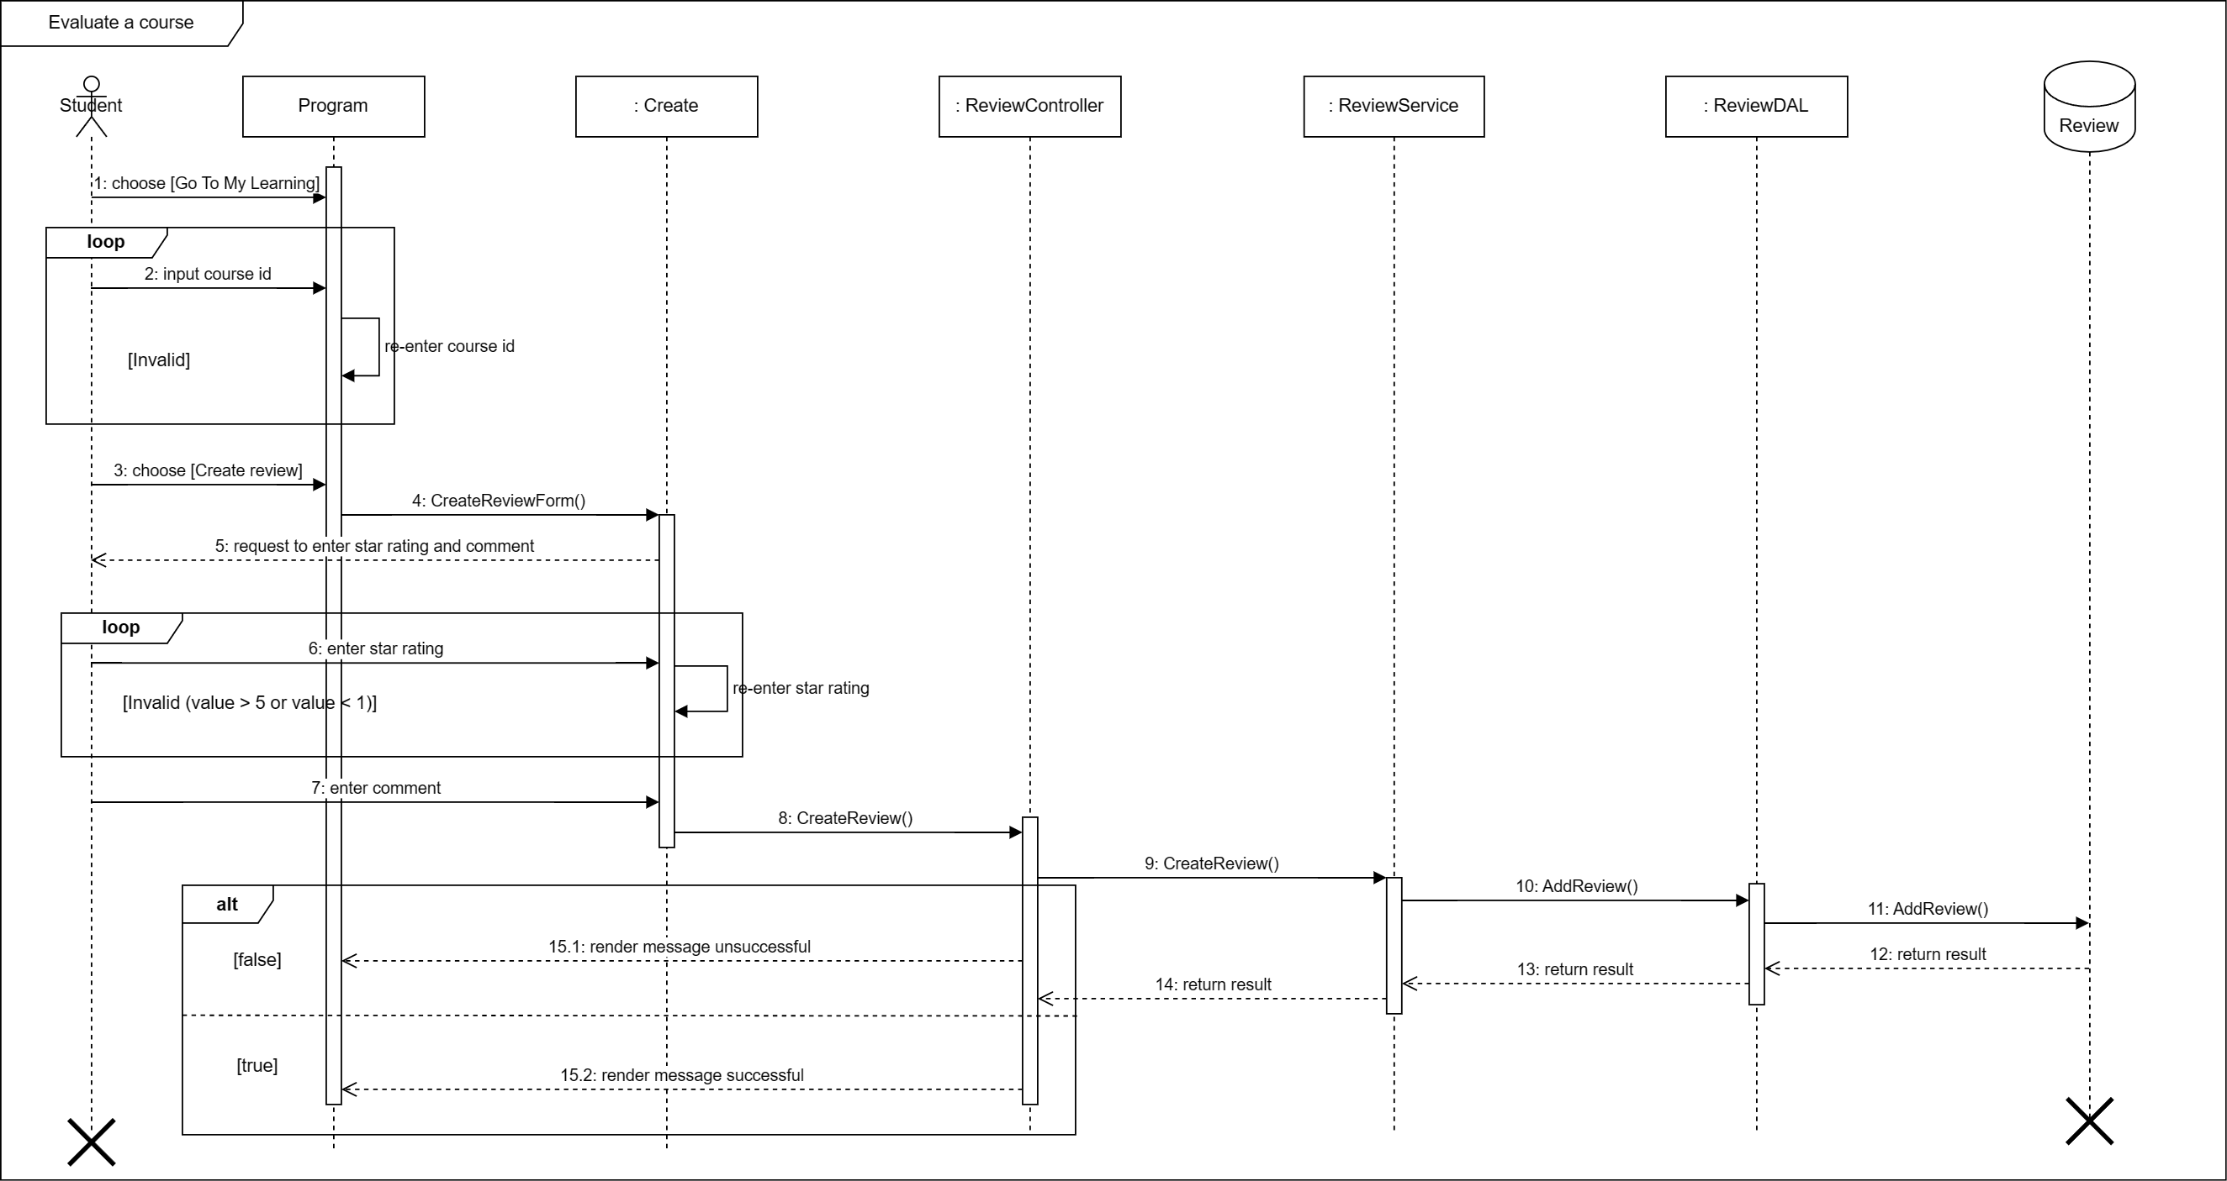
Sequence Diagram

Slide 20
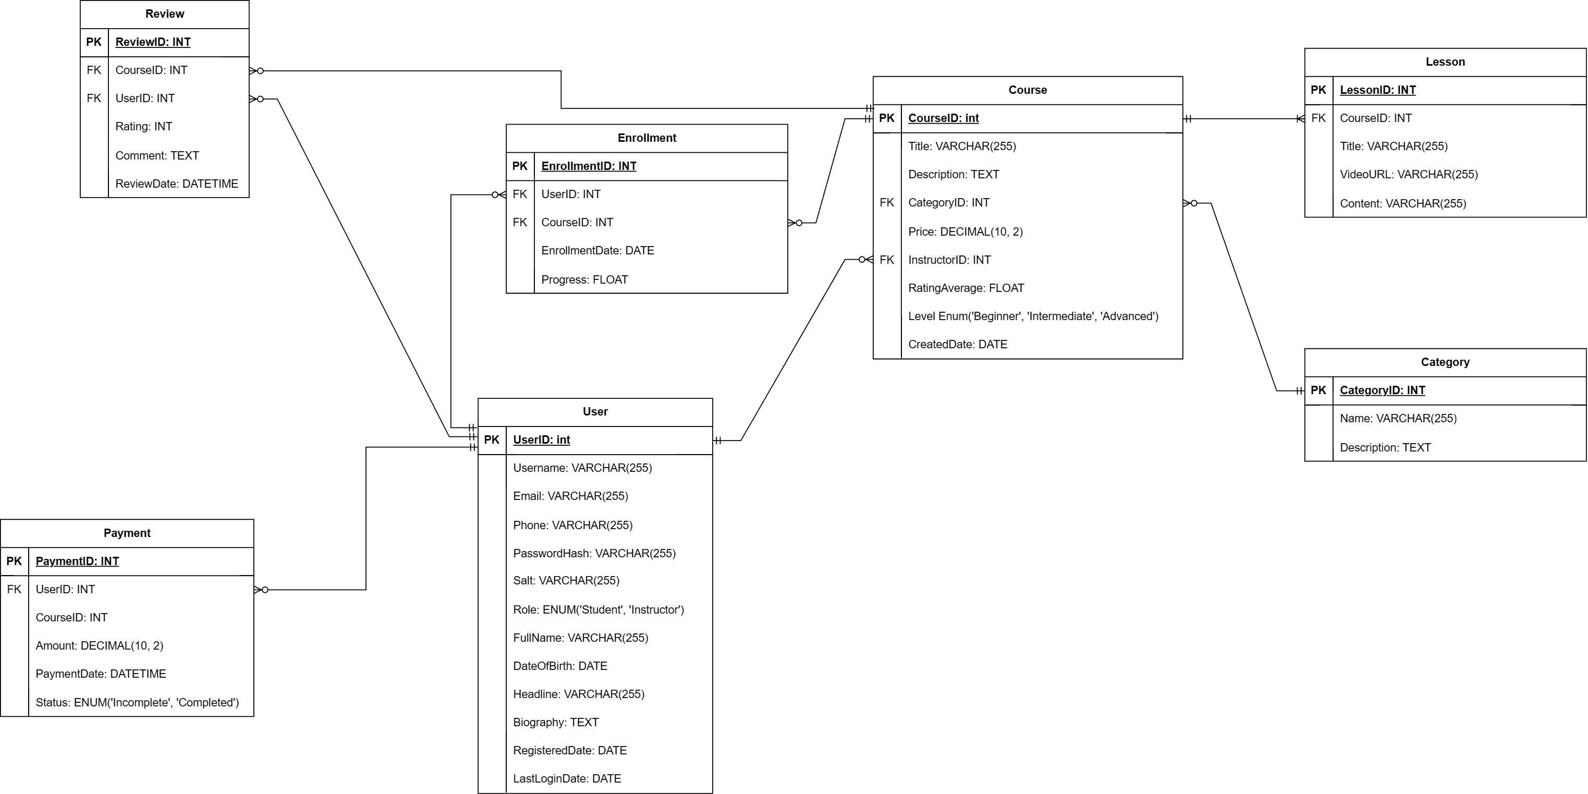
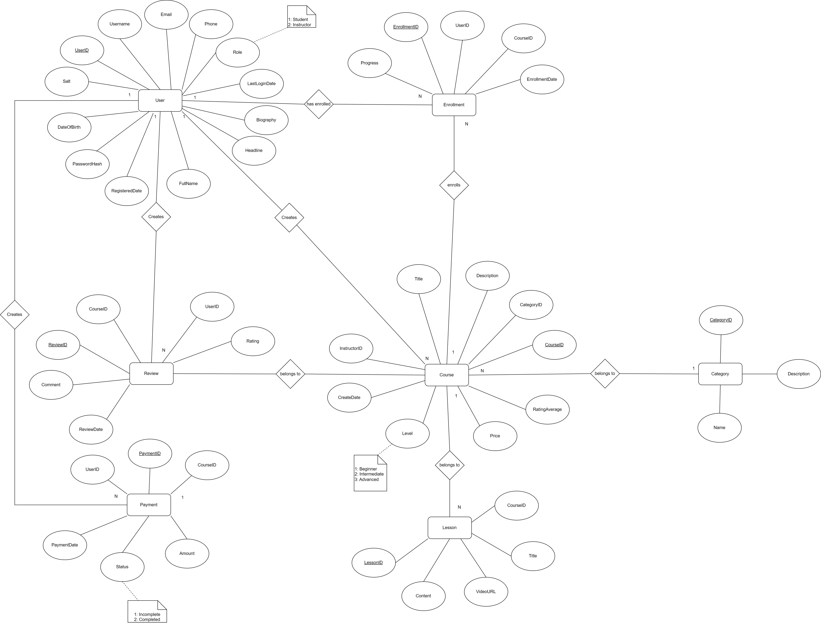
Entity Relationship Diagram

Slide 21
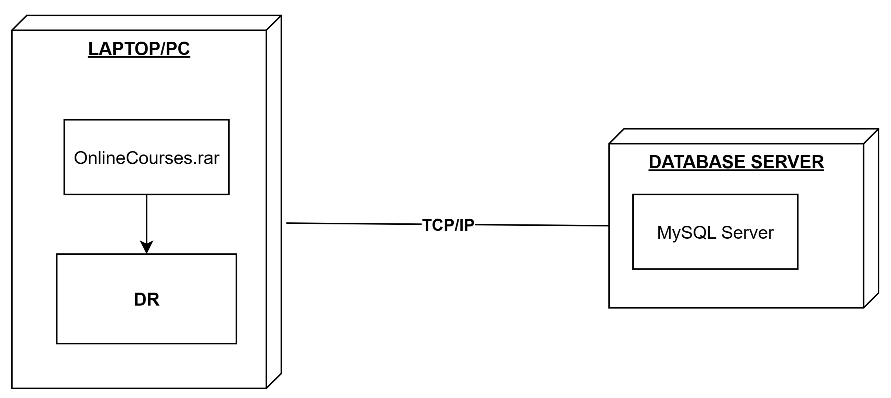
Deployment Diagram

Slide 22
Experience Learned
Project Management
Teamwork
Business Analysis, Design Before Coding

Slide 23


Slide 24
Q & A

